Slide 1
PROFESSIONAL ETHICS CE 3142 CASE STUDIES - B
Faculty of Engineering,
General Sir John Kotelawala Defence University
15th March 2024

Slide 2
TOPICS
DHAKA GARMENT FACTORY COLLAPSE 2013
EXXON VALDEZ OIL SPILL 1989
COLUMBIA SPACE SHUTTLE 2003
THE BHOPAL GAS LEAK TRAGEDY 1984

Slide 3
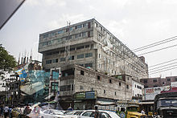
DHAKA GARMENT FACTORY COLLAPSE 2013

Slide 4
Dhaka garment factory collapse
The 2013 Dhaka garment factory collapse (also referred to as the Rana Plaza collapse) was a structural failure that occurred on Wednesday 24 April 2013 in the Savar Upazila of Dhaka District, Banglades.
Here an eight-story commercial building called Rana Plaza collapsed. The search for the dead ended on 13 May 2013 with a death toll of 1,134. Approximately 2,500 injured people were rescued from the building alive. It is considered the one of the most serious building structural failure accident in modern human history and the deadliest garment-factory disaster in history.
The building contained clothing factories, a bank, apartments, and several shops. The shops and the bank on the lower floors were immediately closed after cracks were discovered in the building. The building's owners ignored warnings to avoid using the building after cracks had appeared the day before. Garment workers were ordered to return the following day, and the building collapsed during the morning rush-hour.

Slide 5
Dhaka garment factory collapse
The building, Rana Plaza, was owned by Sohel Rana, politically influential businessman.
It housed a number of separate garment factories employing around 5,000 people, several shops, and a bank. The factories manufactured apparel for well-known brands.
The head of the Bangladesh Fire Service & Civil Defence, said that the upper four floors had been built without a permit.
Rana Plaza's architect, said the building was planned for shops and offices – but not factories.
Other architects / engineers stressed the risks involved in placing factories inside a building designed only for shops and offices, noting the structure was potentially not strong enough to bear the weight and vibration of heavy machinery.

Slide 6
Dhaka garment factory collapse
On 23 April 2013 (one day before the collapse), a TV channel recorded footage that showed cracks in the Rana Plaza building. Immediately afterward, the building was evacuated, and the shops and the bank on the lower floors were closed.
Later in the day, Sohel Rana together with an official of the Local Authority, told the media that the building was safe and workers should return the next day.
Managers at some garment factories threatened to withhold a month's pay from workers who refused to come to work.

Slide 7
Dhaka garment factory collapse
Collapse and rescue
On the morning of 24 April, there was a power outage, and diesel generators on the top floor were started.
The building collapsed at about 08:57 am BST, leaving only the ground floor intact. Officials confirmed that 3,122 workers were in the building at the time of the collapse
More than half of the victims were women, along with a number of their children who were in nursery facilities within the building.
The United Nations' International Search and Rescue Advisory Group, offered assistance from its members, but this offer was rejected by the government of Bangladesh.
The government made a statement suggesting that the area's local rescue emergency services were well equipped

Slide 8
Dhaka garment factory collapse
Collapse and rescue
Prior to offering assistance to Bangladesh, the UN held consultations to assess the country's ability to mount an effective rescue operation, and they reached the conclusion that they lacked that capability.
Bangladeshi officials, desiring to take "face-saving" actions and protect national sensibilities, refused to accept the assistance offered to them by the UN.
A large portion of the rescue operation consisted of inadequately equipped volunteers, many of whom had no protective clothing and wore sandals..
Not only was the Bangladeshi government accused of favouring national pride over those buried alive, but many relatives of those trapped in the debris criticised the government for trying to end the rescue mission prematurely.

Slide 9
Dhaka garment factory collapse
POSSIBLE REASONS FOR FAILURE:
Building built on a filled-in pond which compromised structural integrity,
Conversion from commercial use to industrial use,
Addition of three floors above the original permit,
The use of substandard construction material (which led to an overload of the building structure aggravated by vibrations due to the generators).
These elements indicated dubious business practices by Sohel Rana and dubious administrative practices in the Local Authorities.

Slide 10
Dhaka garment factory collapse -Ethical Issues
The building's owners ignored warnings to avoid using the building after cracks had appeared the day before [disregard safety of humans, ignoring expert advise]
The plan was approved for five floors, but subsequently the owner added three more floors, without due consideration of the level of risk and the safety of life and property
It appears that no design checks were done for the integrity of the foundation and structure to ensure that safety was not compromised [disregards of safety, probable corruption ]
Contractor undertaking the construction of extra floors, that apparently had not been authorized and approved by the Local Authority [violation of engineering standards, conflict of interest, probable corruption]
The use of the commercial building for industrial applications without approval of the LA [violation of building codes, commercial above technical considerations]
Lack of control and monitoring by Local Authority, which questions the integrity of the LA officials [probable corruption]

Slide 11
Dhaka garment factory collapse -Ethical Issues
The head of the Bangladesh Fire Service & Civil Defence, said that the upper four floors had been built without a permit. [failure to “whistle blow”]
Managers at some garment factories threatened to withhold a month's pay from workers who refused to come to work [disregard of safety of humans]
The ill-equipped Bangladesh Govt’s refusal to accept UN aid for rescue operations, reflects on their lack of concern for their people, because of their “pride” [failure to listen to expert advice]
This is further highlighted by the fact that a large percentage of those trapped in the wreckage were women and children [disregard of safety of humans]
The inadequacy of the local rescue teams, who were un-trained and lacked PPE and equipment, placing them at risk in the collapsed structure [unpreparedness due to lack of training and competence]

Slide 12
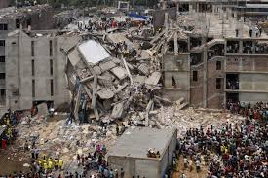
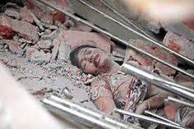
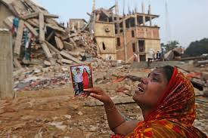
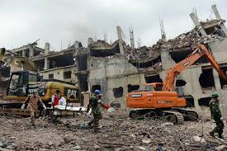
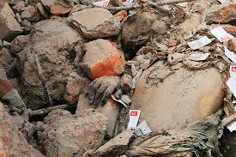
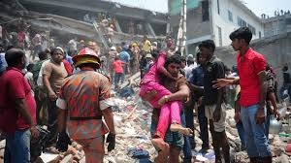
Dhaka garment factory collapse

Slide 13
Dhaka garment factory collapse - Acknowledgement
https://en.wikipedia.org/wiki/2013_Dhaka_garment_factory_collapse
https://www.pinterest.co.uk-Dhaka-garment-factory-collapse
https://www.csmonitor.com/World/Global-News/2013/0426/After-Dhaka-garment-factory-collapse-chances-for-supply-chain-changes-low
https://www.thestar.com/business/economy/2013/05/17/finding_a_solution_to_tragedies_like_rana_plaza_olive.html
https://www.canadianbusiness.com/blogs-and-comment/rana-plaza-collapse-anniversary/
https://www.ft.com/content/bf534db4-acbe-11e2-b27f-00144feabdc0

Slide 14
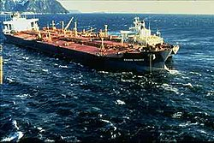
Exxon Valdez oil spill 1989

Slide 15
Exxon Valdez oil spill
BACKGROUND
The Exxon Valdez oil spill occurred in Prince William Sound, Alaska, March 24, 1989, when Exxon Valdez, an oil tanker owned by Exxon Shipping Company, bound for Long Beach, California, struck Prince William Sound's Bligh Reef, 1.5 mi (2.4 km) west of Tatitlek, Alaska, and spilled 10.8 million US gallons (37,000 metric tonnes) of crude oil over the next few days.
It is considered the worst oil spill worldwide in terms of damage to the environment.
Prince William Sound's remote location, accessible only by helicopter, plane, or boat, made government and industry response efforts difficult and severely taxed existing response plans.
The region is a habitat for salmon, sea otters, seals and seabirds.
The oil, originally extracted at the Prudhoe Bay Oil Field, eventually affected 1,300 miles (2,100 km) of coastline.

Slide 16
Exxon Valdez oil spill
The SPILL
The ship was carrying 53.1 million US gallons of oil, of which about 10.8 million US gallons were spilled into the Prince William Sound.
During the first few days of the spill, heavy sheens of oil covered large areas of the surface of Prince William Sound.
Multiple factors have been identified as contributing to the Incident:
Exxon Shipping Company failed to supervise the master and provide a rested and sufficient crew for Exxon Valdez. Investigators found this was widespread throughout the industry, prompting a safety recommendation to Exxon and to the industry.
The third mate failed to properly maneuver the vessel, possibly due to fatigue or excessive workload.
Exxon Shipping Company failed to properly maintain the Raytheon Collision Avoidance System (RAYCAS) radar, which, if functional, would have indicated to the third mate an impending collision with the Bligh Reef by detecting the "radar reflector", placed on the next rock inland from Bligh Reef for the purpose of keeping ships on course.

Slide 17
Exxon Valdez oil spill
The SPILL
Captain Joseph Hazelwood, who was widely reported to have been drinking heavily that night, was not at the controls when the ship struck the reef. As the senior officer in command of the ship, he was accused of being intoxicated and thereby contributing to the disaster.
At the helm, the third mate may never have collided with Bligh Reef had his RAYCAS radar being functioning. But the radar had been out of commission for more than a year before the disaster, and Exxon management knew it. It was just too expensive to fix and operate.

Slide 18
Exxon Valdez oil spill
The SPILL
Other factors, according to investigations included:
Ships were not informed that the previous practice of the Coast Guard tracking ships out to Bligh Reef had ceased.
The oil industry promised, but never installed, state-of-the-art iceberg monitoring equipment.
Exxon Valdez was sailing outside the normal sea lane to avoid small icebergs thought to be in the area.
Coast Guard vessel inspections in Valdez were not performed, and the number of staff was reduced.
Lack of available equipment and personnel hampered the spill cleanup.

Slide 19
Exxon Valdez oil spill
Clean-up and major effects
Chemical dispersant, a surfactant and solvent mixture, was applied to the slick by a private company, but the helicopter missed the target area.
Scientific data on its toxicity were either inadequate or incomplete.
In addition, public acceptance of a new, widespread chemical treatment was lacking. Landowners, fishing groups, and conservation organizations questioned the use of chemicals on hundreds of miles of shoreline when other alternatives may have been available.
The main component of the Corexit formulation used during cleanup, 2-butoxyethanol, was identified as "one of the agents that caused liver, kidney, lung, nervous system, and disorders among cleanup crews in Alaska following the 1989 Exxon Valdez spill.

Slide 20
Exxon Valdez oil spill
Clean-up and major effects
Mechanical cleanup was started shortly afterwards using booms and skimmers, but, and thick oil and kelp tended to clog the equipment.
Despite civilian insistence for a complete clean, only 10% of total oil was actually completely cleaned.
Exxon was widely criticized for its slow response to cleaning up the disaster and the mayor of Valdez, has said his community felt betrayed by Exxon's inadequate response to the crisis. More than 11,000 Alaska residents, along with some Exxon employees, worked throughout the region to try to restore the environment.
Cleaning with high-pressure hot water, tended to displace and destroy the microbial populations on the shoreline; many of these organisms (e.g. plankton) are the basis of the coastal marine food chain, and others (e.g. certain bacteria and fungi) are capable of facilitating the biodegradation of oil.

Slide 21
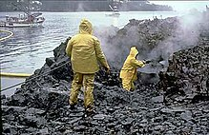
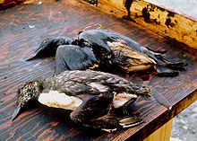
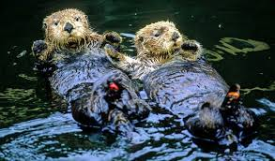
Exxon Valdez oil spill
Clean-up and major effects
Both the long-term and short-term effects of the oil spill have been studied. Immediate effects included the deaths of 100,000 to as many as 250,000 seabirds, at least 2,800 sea otters, approximately 12 river otters, 300 harbor seals, 247 bald eagles, and 22 orcas, and an unknown number of salmon and herring.

Slide 22
Exxon Valdez oil spill – Ethical Issues
The non-availability of the Captain Hazelwood to steer the vessel through the Prince William Sound
The Captain was asleep, being intoxicated,
Coast Guard officers tested Captain Hazelwood for alcohol nine hours after the wreck. The test showed that Hazelwood had a blood-alcohol content of 0.061, in excess of permitted level of 0.04. [irresponsible conduct, knowing that he was the only person qualified to steer ship, disregard for charge of valuable asset]
The vessel was under the command of an officer, who was not authorized to steer the ship in those waters
Exxon Valdez was under the command of Third Mate Gregory Cousins, who was not licensed to pilot the vessel through the waters of Prince William Sound [beyond level of competence]

Slide 23
Exxon Valdez oil spill – Ethical Issues
Disregarding advise given, and failure to get further advise from experts.
The Captain, who took over after the accident, tried for an hour to rock the tanker free from the reef, ignoring Coast Guard advice that rocking the ship might make the oil spill much worse. [disregard of CG advice, failure to get expert advice from Exxon]
Inadequate preparedness with contingency plans
Alyeska Pipeline Service (APS), in the first line of defense against oil spills, nor Exxon had enough containment booms and chemical dispersants to fight the spill. The Exxon Valdez was not fully encircled by containment booms until Saturday afternoon, 36 hours after the accident. By then the oil spill covered an area of 12 square miles. [APS unprepared to contain spread of oil spill]

Slide 24
Exxon Valdez oil spill – Ethical Issues
4. Inadequate preparedness with contingency plans (contd)
A state audit of Alyeska’s equipment demonstrated that the company was unprepared for the spill.
It was supposed to have three tugboats and 13 oil skimmers available but had only two and seven, respectively.
Furthermore, the company had only 14,000 feet of boom for containing spills rather than the 21,000 feet specified in the contingency plan,
the barge that carried the booms and stored skimmed oil was out of service because it had been damaged in a storm. However the available equipment would not have been enough to encircle the giant ship and contain a sizable slick. [APS equipment inadequate to contain spread of oil spill - their total disregard for minimizing the adverse environmental impact]

Slide 25
Exxon Valdez oil spill – Ethical Issues
Inadequate preparedness with contingency plans (contd)
In the event of an oil spill, emergency crews were to encircle the spill with containment booms within five hours—yet it took them 36 hours to encircle the Exxon Valdez.
The main component of the formulation used during cleanup was identified as an agents that has serious ill-effects on human body organs. [disregard for human health and welfare in use of toxic chemicals]
“The oil companies’ lack of preparedness makes a mockery of a 250-page containment plan, approved by the state, for fighting spills in Prince William Sound.” Wall Street Journal

Slide 26
Exxon Valdez oil spill – Ethical Issues
5. Deviation from recommended safety design for tankers to cut costs
APS promised in 1972 that the tanker fleet operating out of Valdez would incorporate safety features such as double hulls and protective ballast tanks to minimize the possibility of spills. However, Alyeska convinced the Coast Guard that the safety features were not necessary, and only a few ships in the Valdez fleet incorporated them.
The Exxon Valdez did not, and eight cargo tanks were ruptured because of inadequate hull strength, due to a single-hulled vessel design. [APS/Exxon conflict of interest - disregard for environmental disaster against cost cutting]
6. Poor maintenance of the vessel
Exxon Shipping Company failed to properly maintain the Raytheon Collision Avoidance System (RAYCAS) radar, which, if functional, would have indicated an impending collision with the Bligh Reef [Exxon disregard for safety of crew and protection of vessel]

Slide 27
Exxon Valdez oil spill
Some of the actual solutions implemented by ExxonMobil after the oil spill are as follows:
Modified tanker routes
Instituted drug and alcohol testing policies for safety-sensitive positions
Restricted safety-sensitive positions to employees with no history of substance abuse
Implemented more extensive periodic assessment of Exxon Mobil vessels and facilities
Strengthened training programs for vessel captains and pilots
Applied new technology to improve vessel navigation and ensure the integrity of oil containment systems
This disaster resulted in International Maritime Organization introducing comprehensive marine pollution prevention rules through various conventions. The rules were ratified by member countries and, under International Ship Management rules, the ships are being operated with a common objective of "safer ships and cleaner oceans"

Slide 28
Exxon Valdez oil spill
https://en.wikipedia.org/wiki/Exxon_Valdez_oil_spill
https://danielsethics.mgt.unm.edu/pdf/ExxonValdezCase.pdf

Slide 29

COLUMBIA SPACE SHUTTLE 2003

Slide 30
COLUMBIA SPACE SHUTTLE
The Space Shuttle Columbia disaster was a fatal incident in the United States space program that occurred on February 1, 2003, when the Space Shuttle Columbia disintegrated as it re-entered the atmosphere, killing all seven crew members. The disaster was the second fatal accident in the Space Shuttle program, after the 1986 breakup of Challenger soon after liftoff.
During the launch of Columbia, a piece of foam insulation broke off from the Space Shuttle external tank and struck the left wing of the orbiter. Similar foam shedding had occurred during previous shuttle launches, causing damage that ranged from minor to nearly catastrophic, but some engineers suspected that the damage to Columbia was more serious.
Before re-entry, NASA managers had limited the investigation, reasoning that the crew could not have fixed the problem if it had been confirmed.
When Columbia re-entered the atmosphere of Earth, the damage allowed hot atmospheric gases to penetrate the heat shield and destroy the internal wing structure, which caused the spacecraft to become unstable and break apart.[

Slide 31
COLUMBIA SPACE SHUTTLE
Debris strike during launch
The shuttle's main fuel tank was covered in thermal insulation foam intended to prevent ice from forming when the tank is full of liquid hydrogen and oxygen. Such ice could damage the shuttle if shed during lift-off.
At 81.7 seconds after launch from Kennedy Space Center, a suitcase-sized piece of foam broke off from the external tank (ET), striking Columbia's left wing reinforced carbon-carbon (RCC) panels. As demonstrated by ground experiments conducted by the Columbia Accident Investigation Board, this likely created a six-to-ten-inch-diameter (15 to 25 cm) hole, allowing hot gases to enter the wing when Columbia later re-entered the atmosphere. At the time of the foam strike, the orbiter was at an altitude of about 65,600 feet (20.0 km), traveling at Mach 2.46.

Slide 32
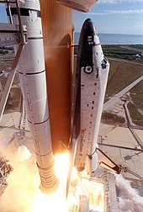
COLUMBIA SPACE SHUTTLE
Insulation had been observed falling off, in whole or in part, on four previous flights. All affected shuttle missions completed successfully. NASA management came to refer to this phenomenon as "foam shedding".
NASA management became accustomed to these phenomena when no serious consequences resulted from these earlier episodes.
This phenomenon was termed "normalization of deviance" by sociologist Diane Vaughan.
Columbia lifting off on its final mission..

Slide 33
COLUMBIA SPACE SHUTTLE
Flight risk management
Video taken during lift-off of Columbia was routinely reviewed two hours later and revealed nothing unusual. The following day, higher-resolution film that had been processed overnight revealed the foam debris striking the left wing, potentially damaging the thermal protection on the Space Shuttle. At the time, the exact location where the foam struck the wing could not be determined due to the low resolution of the tracking camera footage.
Engineers suggestions to NASA for imaging to inspect possible damage, and to engineers' requests about the status of astronaut inspection of the left wing, were turned down by NASA

Slide 34
COLUMBIA SPACE SHUTTLE
Engineers made three separate requests for Department of Defense (DOD) imaging of the shuttle in orbit to determine damage more precisely. While the images were not guaranteed to show the damage, the capability existed for imaging of sufficient resolution to provide meaningful examination.
NASA management did not honor the requests and in some cases intervened to stop the DOD from assisting.
In the risk-management scenario, NASA management failed to recognize the relevance of engineering concerns for safety

Slide 35
COLUMBIA SPACE SHUTTLE
Throughout the risk assessment process, senior NASA managers were influenced by their belief that nothing could be done even if damage were detected. This affected their stance on investigation urgency, thoroughness and possible contingency actions
NASA managers ultimately accepted the rationale to reduce predicted damage of the leading edge panels from possible complete penetration to slight damage to the panel's thin coating.
Ultimately the NASA Mission Management Team felt there was insufficient evidence to indicate that the strike was an unsafe situation, so they declared the debris strike a "turnaround" issue (not of highest importance) and denied the requests for the Department of Defense images.

Slide 36
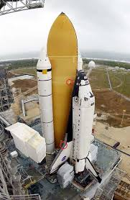
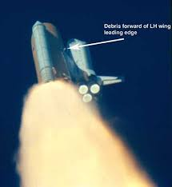
COLUMBIA SPACE SHUTTLE

Slide 37
COLUMBIA SPACE SHUTTLE-ETHICAL ISSUES
NASA management failed to recognize the relevance of engineering concerns for safety
NASA Engineers requested Management for thermal imaging to inspect for possible damage
Engineers request for on board Astronaut to inspect
Engineers made three separate requests for Department of Defense (DOD) imaging of the shuttle in orbit to determine damage more precisely
ALL THESE WERE REJECTED !!!
NASA Management was guilty of “normalization of deviance”
They were negligent in taking for granted “foam shedding” and assuming that slight damage would result:
- Downgrade from complete penetration to slight damage to the wing panel's thin coating.

Slide 38
COLUMBIA SPACE SHUTTLE ETHICAL ISSUES
NASA Managers disregards for the “safety, health and welfare” of the space shuttle crew
“You know, there is nothing we can do about damage to the [thermal protection system]. If it has been damaged it's probably better not to know. I think the crew would rather not know. Don't you think it would be better for them to have a happy successful flight and die unexpectedly during entry than to stay on orbit, knowing that there was nothing to be done, until the air ran out?”

Slide 39
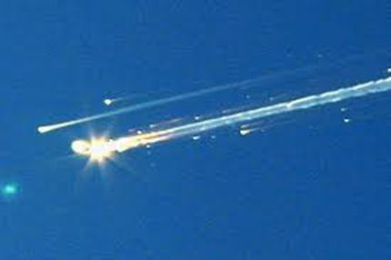
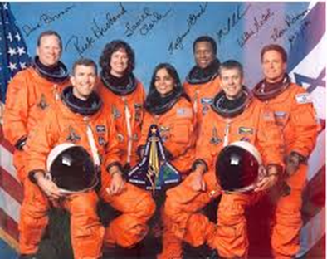
COLUMBIA SPACE SHUTTLE

Slide 40
ACKNOWLEDGEMENT
https://en.wikipedia.org/wiki/Space_Shuttle_Columbia_disaster
https://www.britannica.com/event/Columbia-disaster

Slide 41
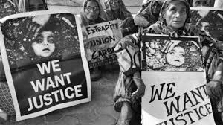
The Bhopal gas leak tragedy 1984

Slide 42
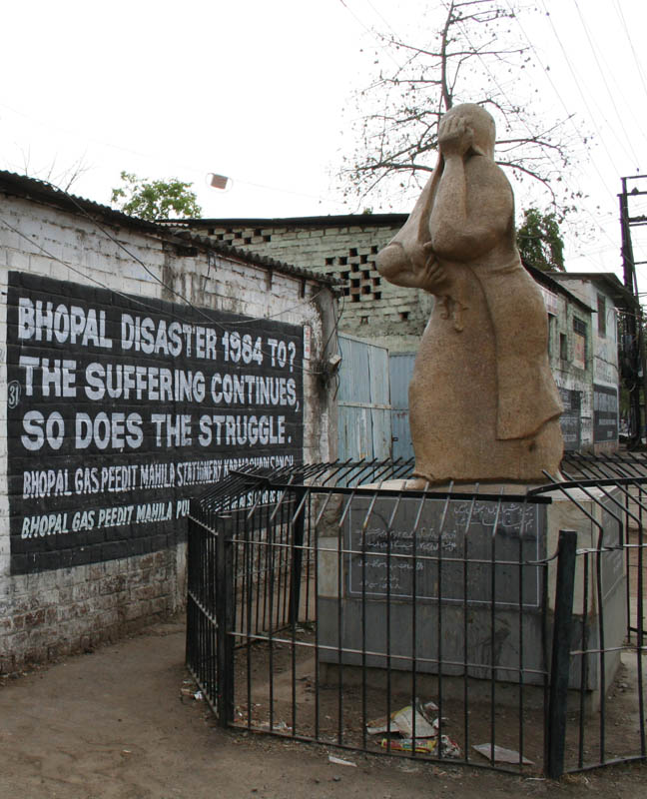
Memorial Statue dedicated to the victims

Slide 43
BACKGROUND
The Bhopal Gas Tragedy, was a gas leak incident on the night of 2–3 December 1984 at the Union Carbide India Limited (UCIL) pesticide plant in Bhopal, Madhya Pradesh, India. It is considered to be the world's worst industrial disaster. Over 500,000 people were exposed to methyl isocyanate (MIC) gas. The highly toxic substance made its way into and around the small towns located near the plant.
The cause of the disaster remains under debate. The Indian Government and local activists argue that slack management and deferred maintenance created a situation where routine pipe maintenance caused a backflow of water into a MIC tank, triggering the disaster. Union Carbide Corporation (UCC) argues water entered the tank through an act of sabotage.
Estimates vary on the death toll. The official immediate death toll was 2,259. In 2008, the government of Madhya Pradesh had paid compensation to the family members of 3,787 victims killed in the gas release, and to 574,366 injured victims.] Others estimate that 8,000 died within two weeks, and another 8,000 or more have since died from gas-related diseases.

Slide 44
BACKGROUND
The UCIL factory was built in 1969 to produce carbaryl for pesticides, using methyl isocyanate (MIC) imported from UCC factories elsewhere. An MIC production plant was added to the UCIL site in 1979
After the Bhopal plant was built, other manufacturers produced carbaryl without MIC, though at a greater manufacturing cost. UCIL continued to use MIC.

Slide 45
Operation - Liquid MIC storage
The Bhopal UCIL facility housed three underground 68,000-liter liquid MIC storage tanks:
UCC safety regulations specified that no one tank should be filled more than 50% (here, 30 tons) with liquid MIC. Each tank was pressurized with inert nitrogen gas. This pressurization allowed liquid MIC to be pumped out of each tank as needed, and also kept impurities out of the tanks.
In late October 1984, tank E610 lost the ability to effectively maintain its nitrogen gas pressure, which meant that the liquid MIC contained within could not be pumped out. At this time tank E610 contained 42 tons of liquid MIC.
Shortly after this failure, MIC production was halted at the Bhopal facility for maintenance. Maintenance included the shutdown of the plant's flare tower
With the flare tower still out of service, production of carbaryl was resumed in late November, using MIC stored in the two tanks still in service.
An attempt to re-establish pressure in tank E610 failed, so the 42 tons of liquid MIC contained within, still could not be pumped out of it.

Slide 46
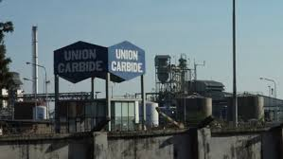
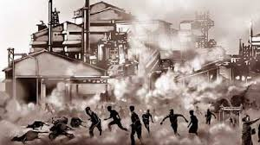
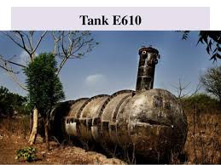
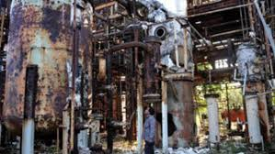

Slide 47
Operation – the gas release
By early December 1984, most of the plant's MIC related safety systems were malfunctioning and many valves and lines were in poor condition. In addition, several vent gas scrubbers had been out of service as well as the steam boiler, intended to clean the pipes.
During the late evening hours of 2 December 1984, water was believed to have entered a side pipe and into Tank E610, having 42 tons MIC, whilst trying to unclog it.
The introduction of water into the tank subsequently resulted in a runaway exothermic reaction, which was accelerated by contaminants, high ambient temperatures and other factors.
The pressure in tank continued to rise: senior refinery employees assumed the reading was due to instrumentation malfunction.
the reaction in tank E610 reached a critical state at an alarming speed, with temperatures and the pressure in the tank rapidly increasing. The emergency relief valve burst open, and pressure in the tank continued to increase; this despite the fact that atmospheric venting of toxic MIC gas had already begun.]
:

Slide 48
Operation – the gas release
Direct atmospheric venting should have been prevented or at least partially mitigated by at least three safety devices which were malfunctioning, not in use, insufficiently sized or otherwise rendered inoperable
A refrigeration system meant to cool tanks containing liquid MIC, shut down in January 1982, and whose freon had been removed in June 1984. Since the MIC storage system required refrigeration, its high temperature alarm, set to sound at 11 °C (52 °F) had long since been disconnected.]

Slide 49
Operation – the gas release
A flare tower, to burn the MIC gas as it escaped, which had had a connecting pipe removed for maintenance, and was improperly sized to neutralise a leak of the size produced by tank E610
A vent gas scrubber, which had been deactivated at the time and was in 'standby' mode, and similarly had insufficient caustic soda and power to safely stop a leak of the magnitude produced
About 30 tonnes of MIC escaped from the tank into the atmosphere in 45 to 60 minutes. This would increase to 40 tonnes within two hours.
The gases were blown in a southeasterly direction over Bhopal.

Slide 50
Effects
The initial effects of exposure were coughing, severe eye irritation and a feeling of suffocation, burning in the respiratory tract, breathlessness, stomach pains and vomiting. People awakened by these symptoms fled away from the plant.
Owing to their height, children and other residents of shorter stature inhaled higher concentrations, as methyl isocyanate gas is approximately twice as dense as air and, therefore, in an open environment has a tendency to fall toward the ground.^{[29]}
Thousands of people had died by the following morning.
Within a few days, trees in the vicinity became barren and bloated animal carcasses had to be disposed of. 170,000 people were treated at hospitals and temporary dispensaries, and 2,000 buffalo, goats, and other animals were collected and buried. Supplies, including food, became scarce owing to suppliers' safety fears. Fishing was prohibited causing further supply shortages.

Slide 51
Ethical Issues - Risk Assessment
This whole disaster started from the lack of risk assessment.
The root of this problem was in locating the site for the factory 4.8 km from the city centre of Bhopal, as the UCC thought that the place is strategic for transportation of goods
a civic minded engineer should be able to foresee the future impact of setting up this factory at the chosen location, where a disastrous accident could happen resulting from human errors or faulty machinery.
In saving the cost of production to gain more income, UCC insisted on picking the place closer to the town center to cut down the cost of transportation even though it is too dangerous for the local citizens who live nearby.
Corporate goals over-riding concerns for the “safety, health and welfare” of the community.

Slide 52
Ethical Issues - Risk Assessment
The action of approving the proposal for the site of this project was professionally unethical for an engineer.
Overlooking the health and safety of the community / failure to object to location of selected factory site

Slide 53
Ethical Issues -Responsibility for Safety
Responsibility for safety is the most important aspect and highest ethical priority of any industry. Engineers must avoid catastrophic failure which could result in loss of property, damage to the environment, and possibly injury or loss of life. The safety, health and welfare of the employees, employers and even the public are of utmost important. A proper EMERGENCY RESPONSE PLAN is a must !!
However, most of the safety systems in the plant were not in operating order.
The vent gas scrubber designed to neutralize the gas was shut down as it was deemed unnecessary during periods when production was suspended.
Moreover, the flare tower could only handle a quarter of the gas that leaked in 1984, and it was out of order because of a repair
To reduce energy costs, the refrigeration system had been shut down for 5 months,
Most of the instrumentation was defective or non-operational
Disregard for safety, with commercial goals over-riding essential engineering needs

Slide 54
Ethical Issues -Responsibility for Safety
Safety Audits were done annually in US and European factories, but every two years in other parts of the world
Bias against third world countries in not carrying out Safety Audits at the period globally / Conflict of Interest – cost of Audit
The tanks storing the MIC gas were overloaded more than 60 percent of capacity based on UCC manuals. The purpose of this is to allocate extra space to dilute the gases in case of emergencies.
Deviation from standard procedures / disregard for safety

Slide 55
Ethical Issues - Responsibility for Safety
Another aspect of responsibility of safety is that the workers were not given proper training / education on the safety procedures. Use of low cost workers reduced UCIL’s expenditure, but the company responsibility was in keeping the workspace safe and accident-free.
Corporate goals taking precedence over technical requirements
Investigations highlight a gradual deterioration of safety practices in regard to the MIC, which had become less relevant to plant operations.
By 1984, only six of the original twelve operators were still working with MIC and the number of supervisory personnel had also been halved. No maintenance supervisor was placed on the night shift and instrument readings were taken every two hours, rather than the previous and required one-hour readings.
Corporate goals taking precedence over technical requirements

Slide 56
Ethical Issues - Responsibility for Safety
Workers made complaints about the cuts through their union but were ignored. One employee was fired after going on a 15-day hunger strike.
70% of the plant's employees were fined before the disaster for refusing to deviate from the proper safety regulations under pressure from the management.
Corporate goals taking precedence over technical requirements
UCIL and the engineers of the chemical plant have failed to ethically adhere to their responsibilities towards safety, and their negligence had ultimately cost the community dearly.

Slide 57
Ethical Issues - Conflict of Interest
In the Bhopal factory, UCIL sought to minimize cost to obtain higher profits as its main motive and priority.
This indirectly lowered the quality of man power, specialization, skill level and morality of workers of the plant .
After the year 1982, safety practices were neglected due to this conflict of interest. This was partly due to a
high turnover of employees,
failure to train new employees’ effectively and
low technical preparedness of the local labour pool.
It can be said that the recruitment and retainment of quality employees for the right job was not preserved, thus giving room for accidents to happen as it was no longer a safe, healthy and supportive workplace.

Slide 58
Ethical Issues - Responsibility
Furthermore, after the disaster breakdown, the director of UCC in UCIL moved back to America, denying the breakdown at the factory was related to him or his company.
He stated that the breakdown was caused by the human errors which came from the workers at the factory and not the management nor the top personnel
The action of UCC denying responsibility for the tragedy and blaming the low-class workers is professionally unethical. They took advantage of the illiterate and uneducated workers of the factory to run away from the blame.
As a result, the government of India fined the UCC in United States for all the loss of lives related to the factory breakdown with the amount of $470 million, and distributed to the family of deceased.

Slide 59
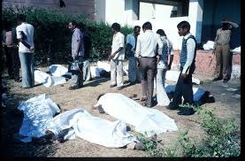
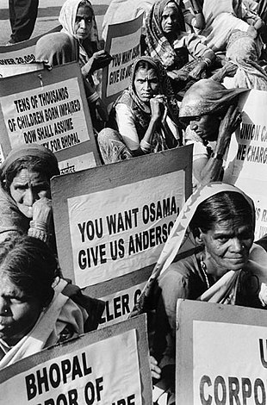
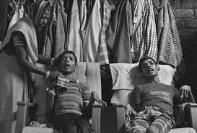
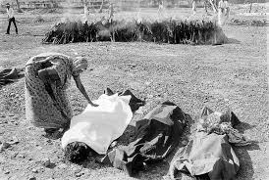
THE AFTERMATH

Slide 60
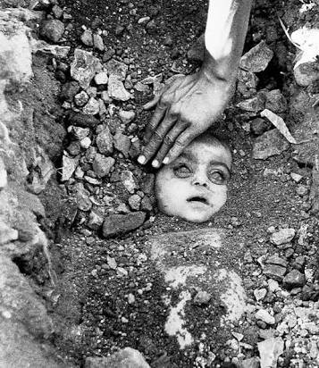
Bhopal Gas Disaster Girl
“Every particle of the soil felt your suffocation where you rested,
Surprisingly the cause of suffocation was still breathing normal.”
There were mass funerals and cremations. Photographer Pablo Bartholemew, on commission with press agency Rapho, took an iconic color photograph of a burial on December 4, Bhopal gas disaster girl. Another photographer present, Raghu Rai, took a black and white photo. The photographers did not ask for the identity of the father or child as she was buried, and no relative has since confirmed it. As such, the identity of the girl remains unknown. Both photos became symbolic of the suffering of victims of the Bhopal disaster, and Bartholomew’s went on to win the 1984 World Press Photo of the Year.

Slide 61
ETHICAL ISSUES
Corporate goals over-riding Engineering and Technical concerns | Dhaka Garment Factory
 | Exxon Valdez oil spill
 | Columbia Space Shuttle
 | Bhopal Gas Leak
Failure to safeguard life and property | Dhaka Garment Factory
 | Columbia Space Shuttle
 | Bhopal Gas Leak
Not making public serious engineering flaws - failure to “whistle blow” | Dhaka Garment Factory
 | Bhopal Gas Leak
Failure to safeguard and prevent environmental damage | Exxon Valdez Bhopal Gas Leak
Conflict of Interest | Dhaka Garmant Factory
 | Bhopal Gas Leak
Working outside Competence | Exxon Valdez

Slide 62
Acknowledgement
https://www.uniassignment.com/essay-samples/construction/ethical-case-study-bhopal-disaster-construction-essay.php
https://en.wikipedia.org/wiki/Bhopal_disaster
https://www.slideshare.net/ankithkadri/bhopal-tragedy-27723477
https://medium.com/@mansimahur/bhopal-gas-disaster-girl-67c789a21fbf
https://www.dnaindia.com/india/report-hazardous-waste-of-union-carbide-to-be-disposed-of-govt-2360516

Slide 63


Slide 64
THANK YOU !!!!!!

